Slide 1
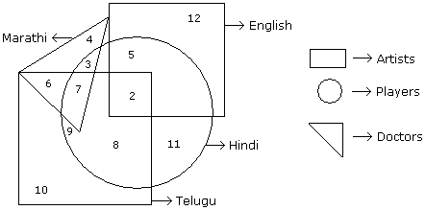
VISUAL REASONING
LOGICAL VENN DIAGRAM (EXERCISE- B)
DIRECTION: In the following figure small square represents the persons who know English, triangle to those who know Marathi, big square to those who know Telugu and circle to those who know Hindi. In the different regions of the figures from 1 to 12 are given.

Slide 2
VISUAL REASONING
LOGICAL VENN DIAGRAM (EXERCISE- B)
Q 1. How many persons can speak English and Hindi both the languages only ?
A.5 B.8 C.7 D.18
Q 2. How many persons can speak Marathi and Telugu both ?
A.10 B.11 C.13 D.None of these
Q 3. How many persons can speak only English ?
A.9 B.12 C.7 D.19
Q 4. How many persons can speak English, Hindi and Telugu ?
A.8 B.2 C.7 D.None of these

Slide 3
VISUAL REASONING
LOGICAL VENN DIAGRAM (EXERCISE- B)
Q 1. How many persons can speak English and Hindi both the languages only ?
A.5 B.8 C.7 D.18
Q 2. How many persons can speak Marathi and Telugu both ?
A.10 B.11 C.13 D.None of these
Q 3. How many persons can speak only English ?
A.9 B.12 C.7 D.19
Q 4. How many persons can speak English, Hindi and Telugu ?
A.8 B.2 C.7 D.None of these

Slide 4
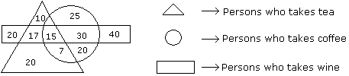
VISUAL REASONING
LOGICAL VENN DIAGRAM (EXERCISE- B)
DIRECTION: In the following figure the different regions are given with different number give the answer accordingly.

Slide 5
VISUAL REASONING
LOGICAL VENN DIAGRAM (EXERCISE- B)
Q 5. How many persons who take tea and wine but not coffee ?
A.20 B.17 C.25 D.15
Q 6. How many persons are there who take both tea and coffee but not wine ?
A.22 B.17 C.7 D.20
Q 7. How many persons take wine ?
A.100 B.82 C.92 D.122
Q 8. How many persons are there who takes only coffee ?
A.90 B.45 C.25 D.20

Slide 6
VISUAL REASONING
LOGICAL VENN DIAGRAM (EXERCISE- B)
Q 5. How many persons who take tea and wine but not coffee ?
A.20 B.17 C.25 D.15
Q 6. How many persons are there who take both tea and coffee but not wine ?
A.22 B.17 C.7 D.20
Q 7. How many persons take wine ?
A.100 B.82 C.92 D.122
Q 8. How many persons are there who takes only coffee ?
A.90 B.45 C.25 D.20

Slide 7
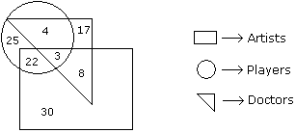
VISUAL REASONING
LOGICAL VENN DIAGRAM (EXERCISE- B)
DIRECTION: In the following figure the different regions are given with different number give the answer accordingly.

Slide 8
VISUAL REASONING
LOGICAL VENN DIAGRAM (EXERCISE- B)
Q 9. How many doctors are neither artists nor players ?
A.17 B.5 C.10 D.30
Q 10. How many doctors are both players and artists ?
A.22 B.8 C.3 D.30
Q 11. How many artists are players ?
A.5 B.8 C.25 D.16

Slide 9
VISUAL REASONING
LOGICAL VENN DIAGRAM (EXERCISE- B)
Q 9. How many doctors are neither artists nor players ?
A.17 B.5 C.10 D.30
Q 10. How many doctors are both players and artists ?
A.22 B.8 C.3 D.30
Q 11. How many artists are players ?
A.5 B.8 C.25 D.16

Slide 10
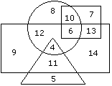
VISUAL REASONING
LOGICAL VENN DIAGRAM (EXERCISE- B)
DIRECTION: In the following diagram rectangle represents men, Triangle represents educated, Circle represents urban and square represents government employees.

Slide 11
VISUAL REASONING
LOGICAL VENN DIAGRAM (EXERCISE- B)
Q 12. Which one of the following represents the educated men but not urban ?
A.9 B.5 C.4 D.11
Q 13. Which one of the following represents a woman who is urban as well as government employee?
A.7 B.13 C.10 D.6

Slide 12
VISUAL REASONING
LOGICAL VENN DIAGRAM (EXERCISE- B)
Q 12. Which one of the following represents the educated men but not urban ?
A.9 B.5 C.4 D.11
Q 13. Which one of the following represents a woman who is urban as well as government employee?
A.7 B.13 C.10 D.6

Slide 13
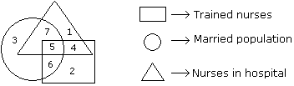
VISUAL REASONING
LOGICAL VENN DIAGRAM (EXERCISE- B)
DIRECTION: In the following figure the different regions are given with different number give the answer accordingly.

Slide 14
VISUAL REASONING
LOGICAL VENN DIAGRAM (EXERCISE- B)
Q 14. If hospital management requires only married trained nurses for operation theater, which part of diagram should be chosen by him ?
A.7 B.4 C.5 D.6
.

Slide 15
VISUAL REASONING
LOGICAL VENN DIAGRAM (EXERCISE- B)
Q 14. If hospital management requires only married trained nurses for operation theater, which part of diagram should be chosen by him ?
A.7 B.4 C.5 D.6
.

